Slide 1
Chapter 4: Properties of the Integers: Mathematical Induction
謝孫源 講座教授
hsiehsy@mail.ntcku.edu.tw
國立成功大學 資訊工程系

Slide 2
Outline
The Well-Ordering Principle: Mathematical Induction
Recursive Definitions
The Division Algorithm: Prime Numbers
The Greatest Common Divisor: The Euclidean Algorithm
The Fundamental Theorem of Arithmetic

Slide 3
The Well-Ordering Principle
Z⁺ = {x ∈ Z | x > 0} = {x ∈ Z | x ≥ 1}.
Q⁺ = {x ∈ Q | x > 0} and R⁺ = {x ∈ R | x > 0}
We cannot represent Q⁺ or R⁺ using ≥ as we did for Z⁺. (If q is a positive rational number, then since 0 < q/2 < q, we would have the smaller positive rational number q/2.)
The Well-Ordering Principle: Every nonempty subset of Z⁺ contains a smallest element. (We often express this by saying that Z⁺ is well ordered.

Slide 4
The Principle of Mathematical Induction (1/3)
Theorem 4.1: The Principle of Mathematical Induction. Let S(n) denote an open mathematical statement (or set of such open statements) that involves one or more occurrences of the variable n, which represents a positive integer.
a) If S(1) is true; and
b) If whenever S(k) is true (for some particular, but arbitrarily chosen, k ∈ Z⁺), then S(k + 1) is true;
then S(n) is true for all n ∈ Z⁺.
Basis step
Inductive step

Slide 5
The Principle of Mathematical Induction (2/3)
Theorem 4.1 (cont.):
Proof. Let F = {t ∈ Z⁺ | S(t) is false}.
(want to prove that F = ∅)
1) To obtain a contradiction, assume that F ≠ ∅.
By the Well-Ordering Principle, F has a least
element m. Since S(1) is true, m ≠1, so m > 1.
m – 1 ∈ Z⁺.
2) With m – 1 ∉ F, S(m – 1) is true.
By condition (b), S((m – 1) + 1) = S(m) is true.
Contradicting m ∈ F. Consequently, F = ∅.
[S(n₀) ∧ [∀k ≥ n₀ [S(k) ⇒ S(k + 1)]]] ⇒ ∀n ≥ n₀ S(n).

Slide 6
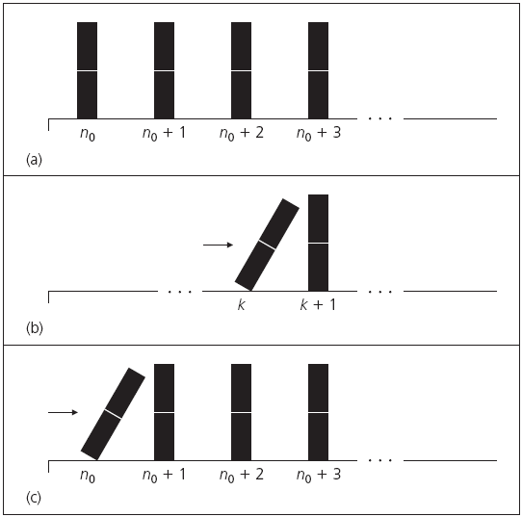
The Principle of Mathematical Induction (3/3)

Slide 7
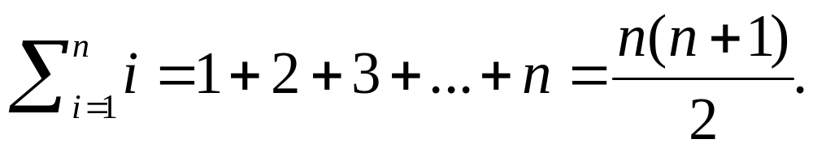
Examples (1/3)
Example 4.1: Prove that for all n ∈ Z⁺,
Notes:
Palindrome: 迴文

Slide 8
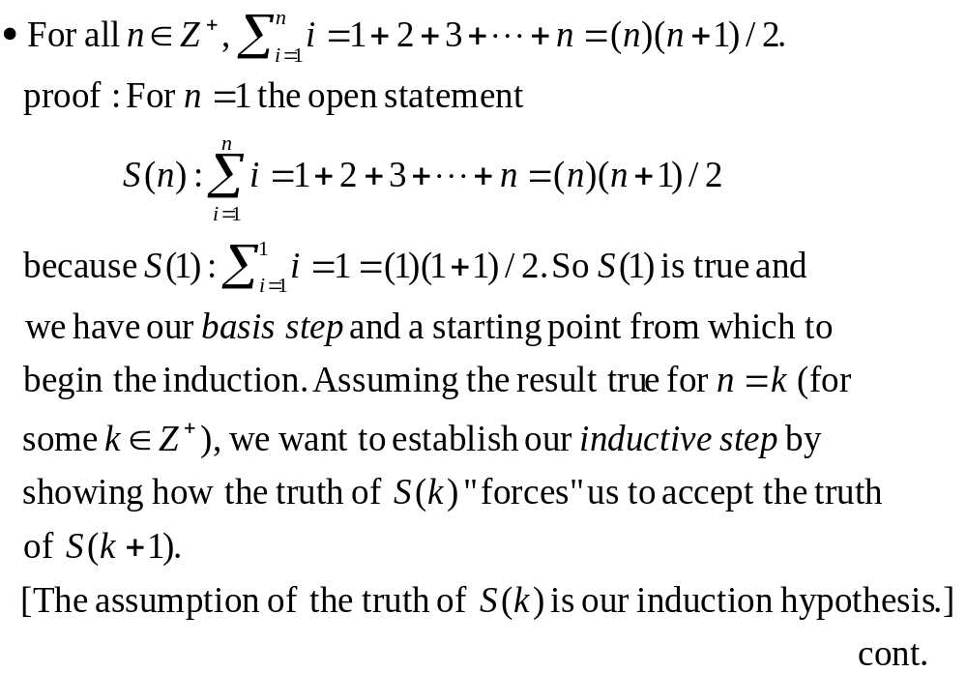

Slide 9
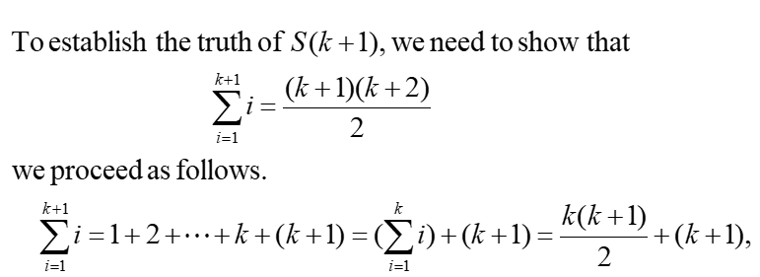
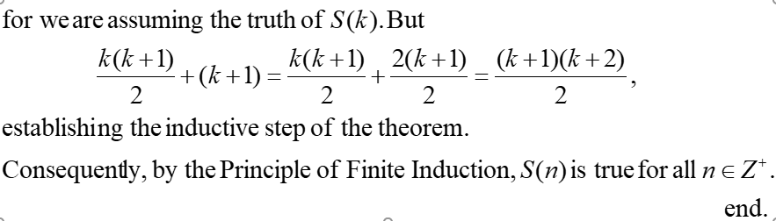

Slide 10
Example 4.3: Among the 900 three-digit integers (from 100 to 999) those such as 131, 222, 303, 717, 848, and 969, where the integer is the same whether it is read from left to right or from right to left, are called palindromes. Without actually determining all of these three-digit palindromes, we would like to determine their sum.

Slide 11
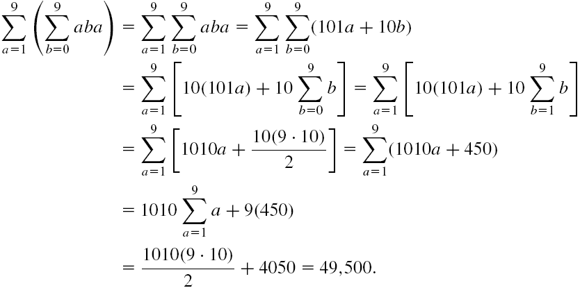
Examples (2/3)
Example 4.3 (cont.):
Notes:
Palindrome: 迴文

Slide 12
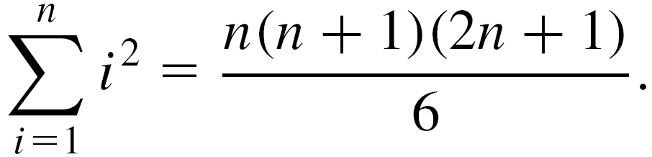
Example (3/3)
Example 4.4: Prove that for each n ∈ Z⁺,

Slide 13
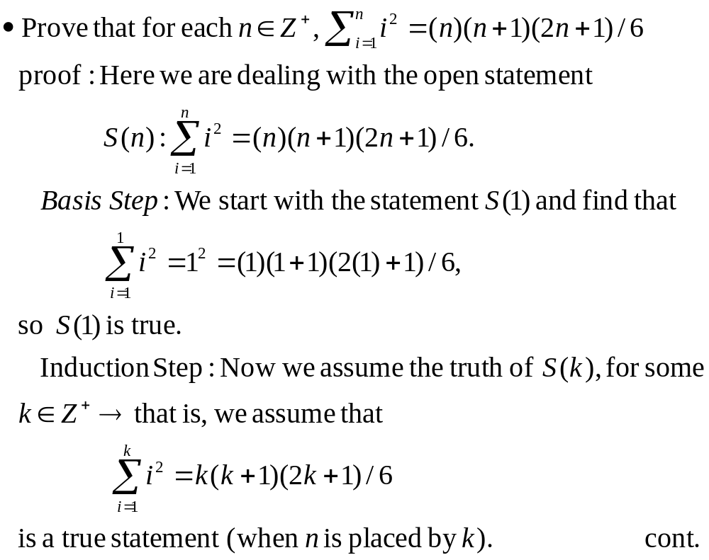

Slide 14
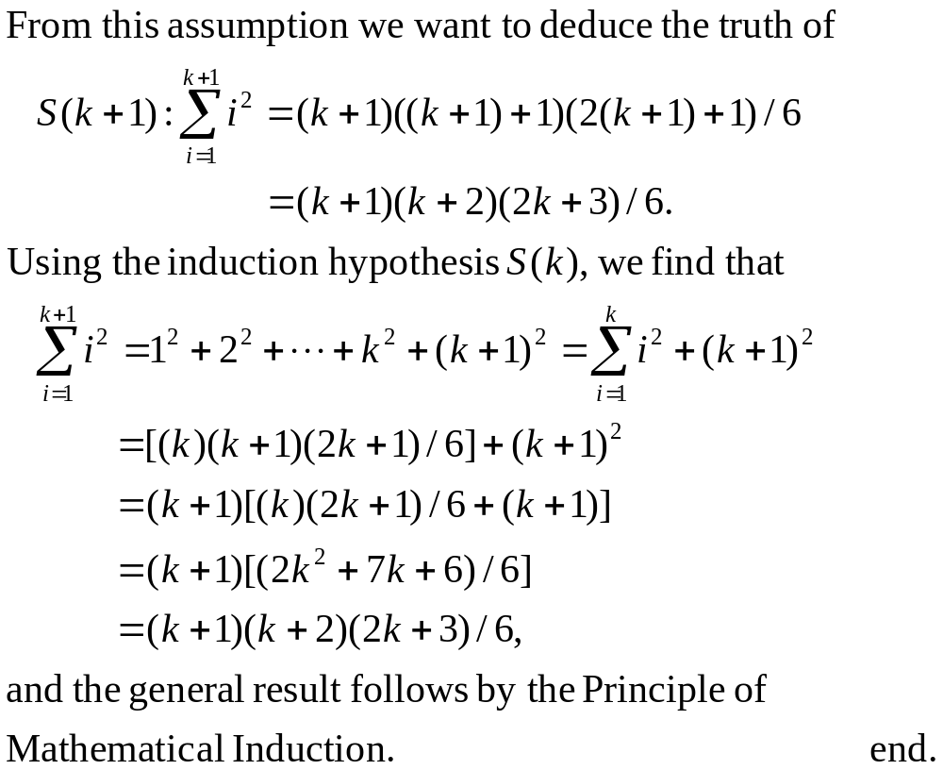

Slide 15
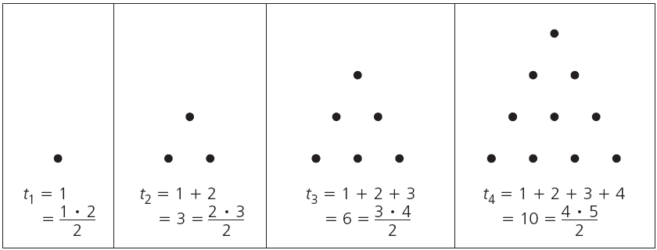
Triangular Numbers (1/2)
Example 4.5: The figure below provides the first four entries of the sequence of triangular numbers. We see that t₁ = 1, t₂ = 3, t₃ = 6, t₄ = 10, and, in general, t_{i} = 1 + 2 + … + i = i(i + 1)/2, for each i ∈ Z⁺.

Slide 16

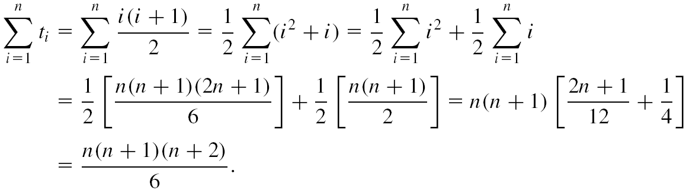
Triangular Numbers (2/2)
Example 4.5 (cont.): For a fixed n ∈ Z⁺ we want a formula for the sum of the first n triangular numbers – that is, .
Considering n fixed (but arbitrary) we find that

Slide 17
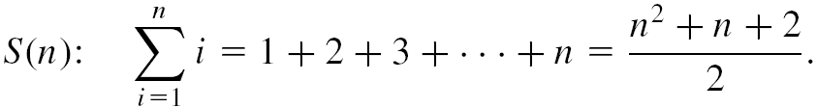
The Need to Establish the Basis Step
Example 4.6: If n ∈ Z⁺, establish the validity of the open statement
What will happen if we go directly to the inductive step?
Let us reconsider Example 4.1.
n(n + 1) = n² + n + 2 and 0 = 2 (Something is wrong somewhere!)
Remember to establish the basis step – no mater how easy it may be to verify it.

Slide 18
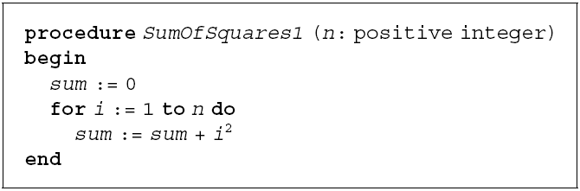
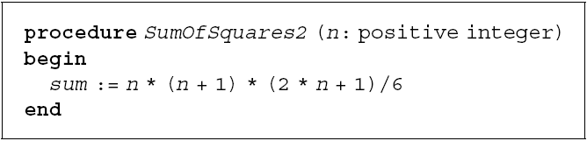
Efficient Procedures
n additions and
n multiplications
2 additions +
3 multiplications +
1 division

Slide 19
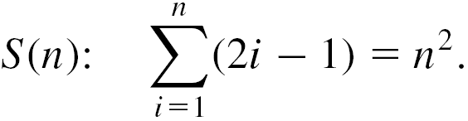
Mathematical Induction Examples (1/3)
Example 4.7: Consider the sums of consecutive odd positive integers.
1) 1 = 1 (= 1²)
2) 1 + 3 = 4 (= 2²)
3) 1 + 3 + 5 = 9 (= 3²)
4) 1 + 3 + 5 + 7 = 16 (= 4²)
Is the following result true?
For all n ∈ Z⁺,

Slide 20
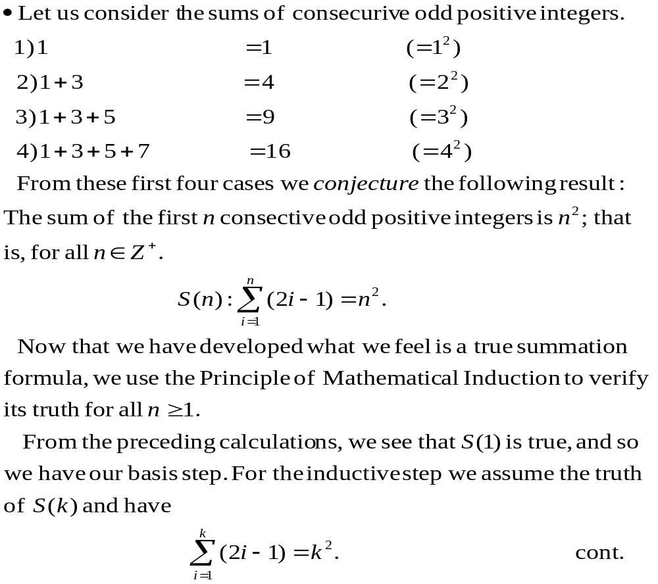

Slide 21
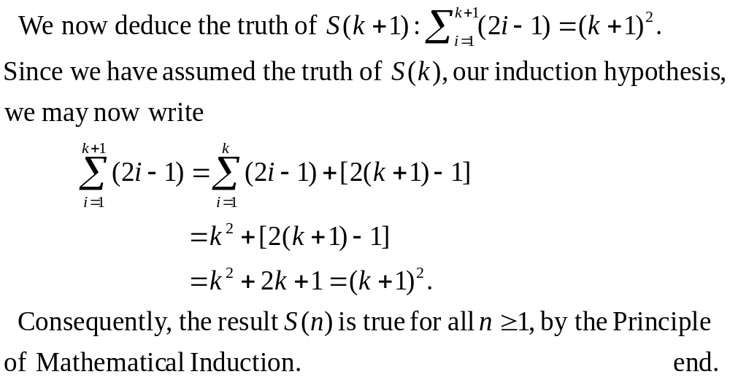

Slide 22

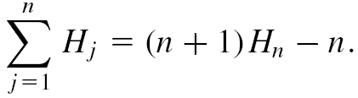
Mathematical Induction Examples (2/3)
Example 4.9: The Harmonic numbers H₁, H₂, H₃ is defined as follows:
H₁ = 1,
H₂ = 1 + 1/2 ,
H₃ = 1 + 1/2 + 1/3, …,
and, in general, , for each n ∈ Z⁺. Prove that for all n ∈ Z⁺,
Hint: H_{k} = H_{k+1} – 1/(k + 1)
Notes:
Hint: Hk = Hk+1 – 1/(k+1)

Slide 23
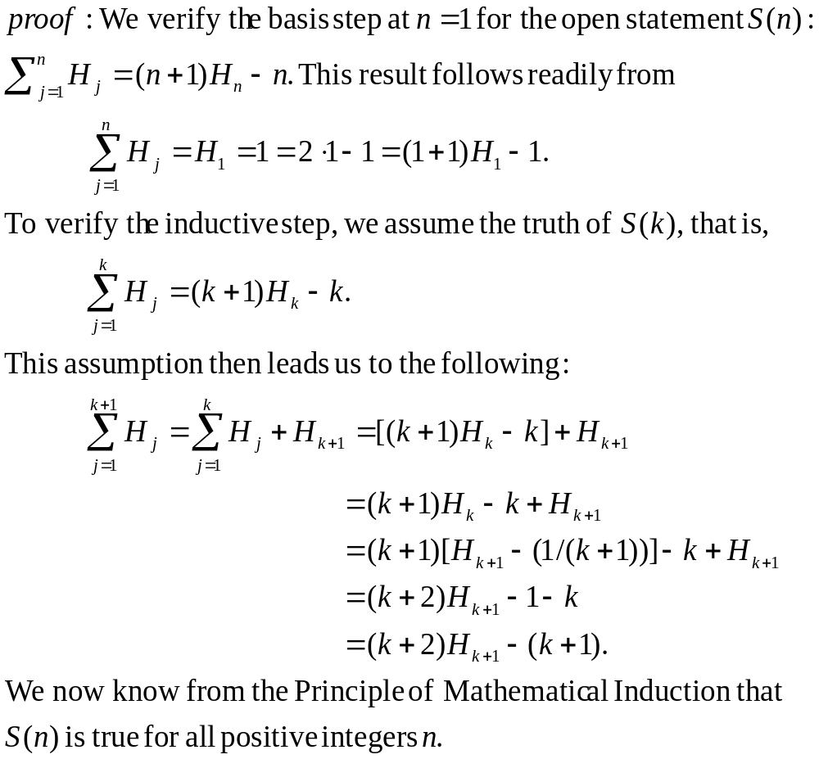

Slide 24
Mathematical Induction Examples (3/3)
Example 4.13: We learn from the equation 14 = 3 + 3 + 8 that we can express 14 using only 3’s and 8’s as summands. But what may prove to be surprising is that for all n ≥ 14,
S(n): n can be written as a sum of 3’s and/or 8’s (with not regard to order).
Notes:
Basis step: S(14)
Inductive step: 1) at least one 8 → replace one 8 by three 3; 2) no 8 → at least five 3’s → replace five 3’s by two 8’s

Slide 25
Principle of Strong Mathematical Induction
Theorem 4.2: The Principle of Mathematical Induction – Alternative Form. Let S(n) denote an open mathematical statement (or set of such open statements) that involves one or more occurrences of the variable n, which represents a positive integer. Also let n₀, n₁ ∈ Z⁺ with n₀ ≤ n₁.
  Basis Step: If S(n₀), S(n₀ + 1), S(n₀ + 2), …, S(n₁ – 1), and S(n₁) are true; and
  Inductive Step: If whenever S(n₀), S(n₀ + 1), …, S(k – 1), and S(k) are true for some (particular but arbitrarily chosen) k ∈ Z⁺, where k ≥ n₁, then the statement S(k + 1) is also true;
then S(n) is true for all n ≥ n₀.

Slide 26
Examples (1/2)
Example 4.14: The following calculations indicate that it is possible to write (without regard to order) the integer 14, 15, 16 using only 3’s and/or 8’s as summands:
14 = 3 + 3 + 8 15 = 3 + 3 + 3 + 3 + 3 16 = 8 + 8
On the basis of these three results, we make the conjecture: For every n ∈ Z⁺ where n ≥ 14,
S(n): n can be written as a sum of 3’s and/or 8’s.
Notes:
Hint: (k + 1) = (k – 2) + 3

Slide 27
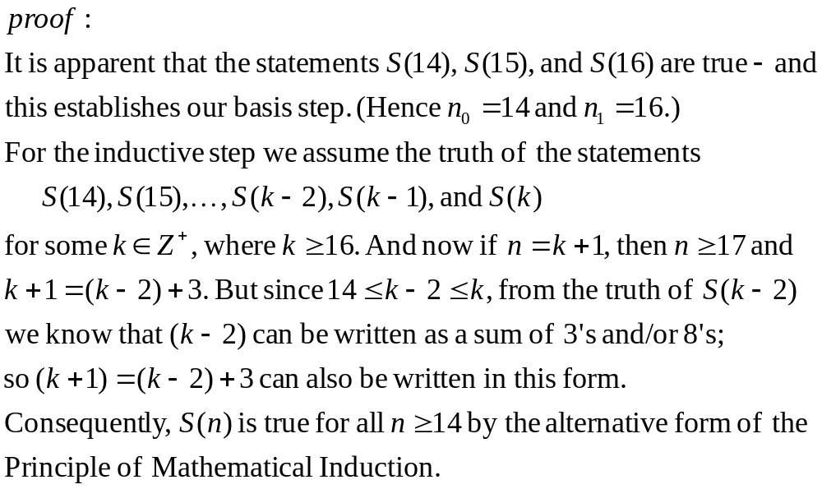

Slide 28
Examples (2/2)
Example 4.15: Let us consider the integer sequence a₀, a₁, a₂, a₃, …, where a₀ = 1, a₁ = 2, a₂ = 3, and a_{n} = a_{n–1} + a_{n–2} + a_{n–3}, for all n ∈ Z⁺ where n ≥ 3. (Then, for instance, we find that a₃ = a₂ + a₁ + a₀ = 3 + 2 + 1 = 6; a₄ = a₃ + a₂ + a₁ = 6 + 3 + 2 = 11; and a₅ = a₄ + a₃ + a₂ = 11 + 6 + 3 = 20.)
We claim that the entries in this sequence are such that a_{n} ≤ 3^{n} for all n ∈ N – that is, ∀n ∈ N S’(n), where S’(n) is the open statement: a_{n} ≤ 3^{n}.
EXERCISES 4.1: 18, 24
Notes:
Hint: ak+1 = ak + ak-1 + ak-2 <= 3^{k} + 3^{k-1} + 3^{k-2} <= 3^{k} + 3^{k} + 3^{k} = 3(3^{k}) = 3^{k+1}.

Slide 29
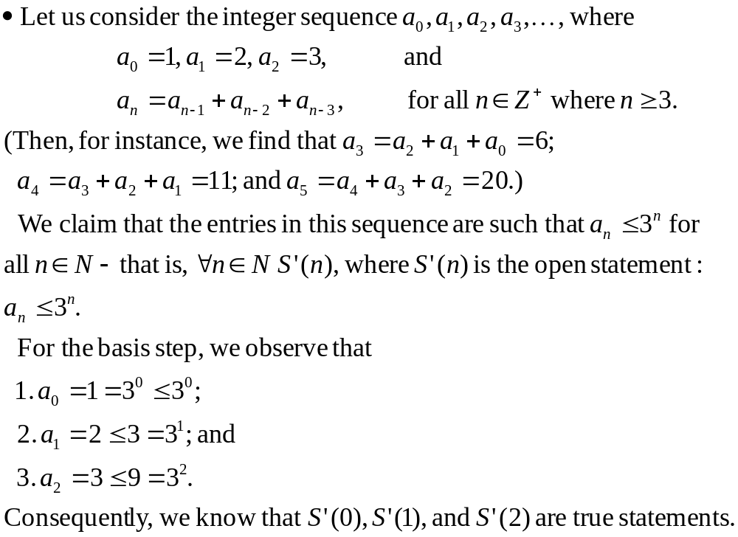

Slide 30
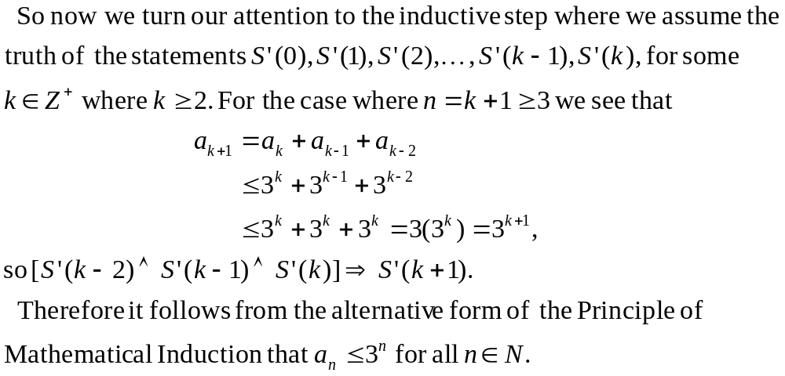

Slide 31
Outline
The Well-Ordering Principle: Mathematical Induction
Recursive Definitions
The Division Algorithm: Prime Numbers
The Greatest Common Divisor: The Euclidean Algorithm
The Fundamental Theorem of Arithmetic

Slide 32
Explicit Formula (1/3)
Consider the integer sequence b₀, b₁, b₂, b₃, …, where b_{n} = 2n for all n ∈ N.
If we need to determine b₆, we simply calculate b₆ = 2 ⋅ 6 = 12 – without the need to calculate the value of b_{n} for any other n ∈ N.
We can perform such calculations because we have an explicit formula – namely, b_{n} = 2n – that tells us how b_{n} is determined from n (alone).
Notes:
N: 自然數, nonnegative integers
Explicit:明確的

Slide 33
Explicit Formula (2/3)
Consider the integer sequence a₀, a₁, a₂, a₃, …, where
a₀ = 1, a₁ = 2, a₂ = 3, and
a_{n} = a_{n–1} + a_{n–2} + a_{n–3}, for all n ∈ Z⁺ where n ≥ 3.
If we want the value of a₆, we need to know the values of a₅, a₄, and a₃. (Because we do not have an explicit formula that defines each a_{n} in terms of n for all n ∈ N.)

Slide 34
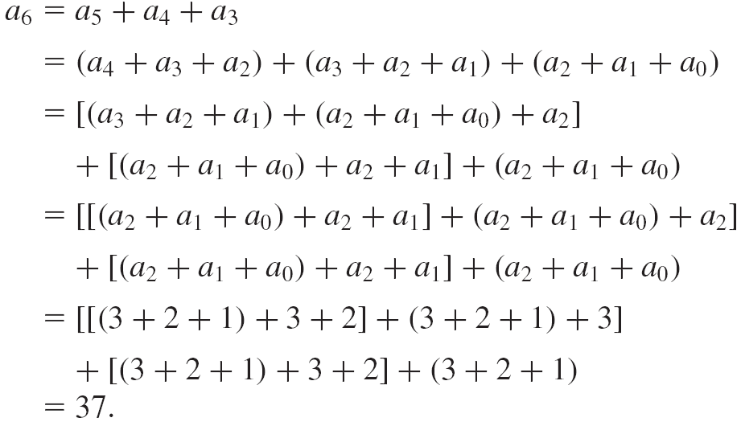
Explicit Formula (3/3)

Slide 35
Recursive Definition
For the sequence a₀, a₁, a₂, a₃, …, we may be able to define what we need in terms of similar prior results.
When we do so we say that the concept is defined recursively, using the method, or process, of recursion.

Slide 36



Examples of Recursive Definition
Harmonic numbers H₁, H₂, H₃, …
n!
Explicit formula b_{n} = 2n, n ∈ N.

Slide 37
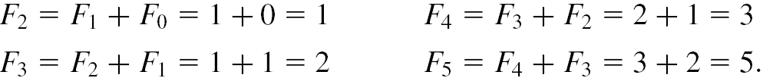
The Fibonacci Numbers (1/2)
Example 4.19: The Fibonacci numbers may be defined recursively by
1) F₀ = 0, F₁ = 1; and
2) F_{n} = F_{n–1} + F_{n–2}, for n ∈ Z⁺ with n ≥ 2.
Hence, from the recursive part of this definition, it follows that

Slide 38
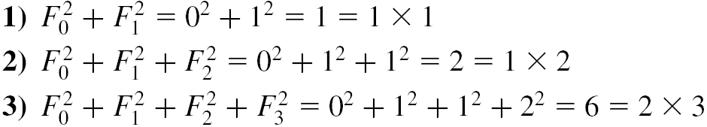

The Fibonacci Numbers (2/2)
Let us consider the following five results that deal with sums of squares of the Fibonacci numbers.
From what is suggested in these calculations, we conjecture that

Slide 39
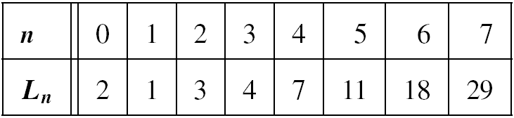
The Lucas Numbers
Example 4.20: The Lucas numbers is defined by
1) L₀ = 2, L₁ = 1; and
2) L_{n} = L_{n–1} + L_{n–2}, for n ∈ Z⁺ with n ≥ 2.
One of the interrelations between the Fibonacci and Lucas numbers is illustrated in the fact that
∀n ∈ Z⁺ L_{n} = F_{n–1} + F_{n+1}.

Slide 40
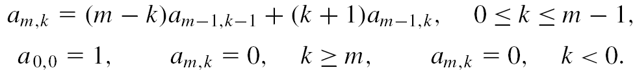
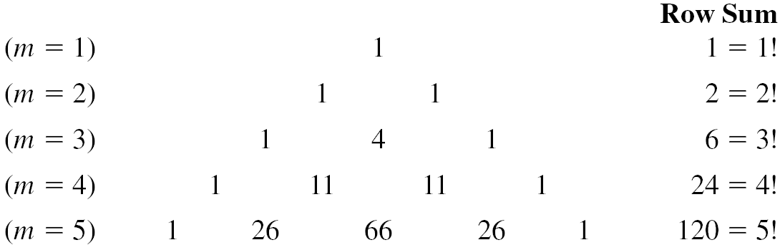
The Eulerian Numbers (1/3)
Example 4.21: For m, k ∈ N, the Eulerian numbers a_{m,k} are defined recursively by
The values for a_{m,k}, where 1≤ m ≤5 and 0 ≤ k ≤m – 1, are given as follows:
Notes:
a_{1,0} = a_{0,-1} + a_{0,0} = 1
a_{2,0} = 2a_{1,-1} + a_{1,0} = 1
a_{2,1} = a_{1,0} + 2a_{1,1} = 1
a_{3,0} = 3a_{2,-1} + a_{2,0} = 1
a_{3,1} = 2a_{2,0} + 2a_{2,1} = 4

Slide 41

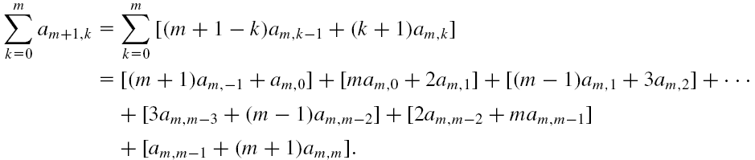
The Eulerian Numbers (2/3)
Example 4.21 (cont.): These results suggest that for a fixed m ∈ Z⁺, , the number of permutations of m objects taken m at a time.
Assuming the result true for some fixed m (≥ 1), we find that

Slide 42
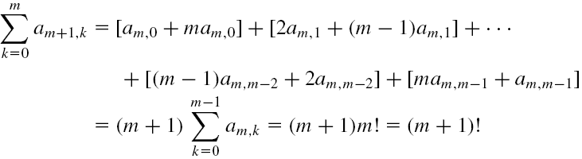
The Eulerian Numbers (3/3)
Example 4.21 (cont.): Since a_{m,–1} = 0 = a_{m,m} we can write
Consequently, the result is true for all m ≥ 1 – by the Principle of Mathematical Induction.

Slide 43
Recursively Defined Set
A recursively defined set X:
  Start with an initial collection of elements that are in X – this provides the base of the recursion.
  A rule or list of rules tell us how to find new elements in X from other elements already known to be in X.
Example 4.22: Define the set X recursively by
1) 1 ∈ X; and
2) For each a ∈ X, a + 2 ∈ X.
Then we claim that X consists (precisely) of all positive odd integers.
EXERCISES 4.2: 12, 16

Slide 44
Outline
The Well-Ordering Principle: Mathematical Induction
Recursive Definitions
The Division Algorithm: Prime Numbers
The Greatest Common Divisor: The Euclidean Algorithm
The Fundamental Theorem of Arithmetic

Slide 45
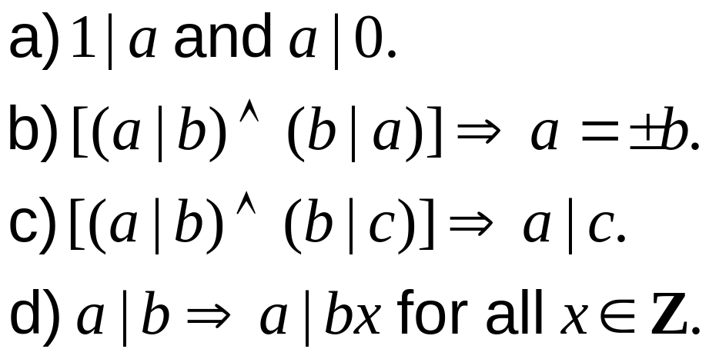
Properties of Division Operation (1/3)
Definition 4.1: If a, b ∈ Z and b ≠ 0, we say that b divides a, and we write b|a, if there is an integer n such that a = bn. When this occurs we say that b is a divisor of a, or a is a multiple of b.
Theorem 4.3: For all a, b, c ∈ Z
Notes:
Divisor: 除數

Slide 46
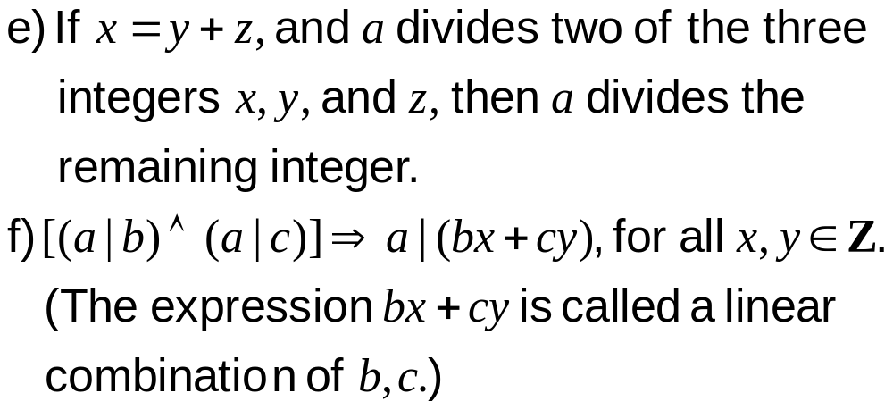
Properties of Division Operation (2/3)
Theorem 4.3 (cont.):

Slide 47
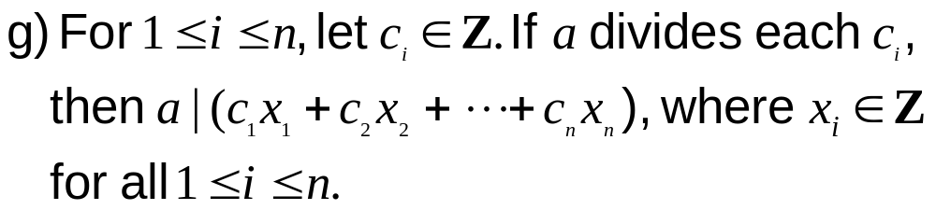
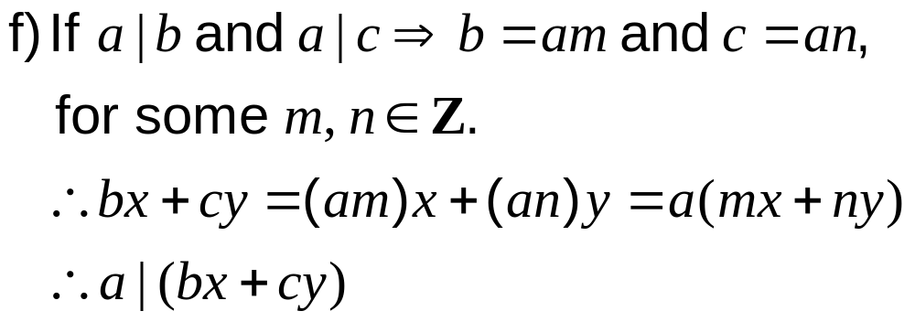
Properties of Division Operation (3/3)
Theorem 4.3 (cont.):
Proof:

Slide 48
Example
Example 4.24: Let a, b ∈ Z so that 2a + 3b is a multiple of 17. (For example, we could have a = 7 and b = 1 – and a = 4, b = 3 also works.) Prove that 17 divides 9a + 5b.
Proof:
17 | (2a + 3b) ⇒ 17 | (–4)(2a + 3b), by part (d)
17 | (17a + 17b), by part (f)
17 | [(17a + 17b) + (–4)(2a + 3b)], by part (e)
Consequently, we have 17 | (9a + 5b).

Slide 49
Prime and Composite (1/3)
Number theory is now an essential applicable tool in dealing with computer and Internet security.
Primes are the positive integers that have only two positive divisors, namely, 1 and n itself. All other positive integers are called composite.
Lemma 4.1: If n ∈ Z⁺ and n is composite, then there is a prime p such that p|n.
Proof: If no such a prime, let S be the set of all composite integers that have no prime divisors.

Slide 50
Prime and Composite (2/3)
Lemma 4.1 (cont.):
By Well-Ordering Principle, S has a least element m.
If m is composite, then m = m₁m₂, where m₁, m₂ ∈ Z⁺ with 1 < m₁ < m and 1 < m₂ < m.
Since m₁∉ S, m₁ is prime or divisible by a prime, so exists a prime p such that p|m₁.
Since p|m₁ and m = m₁m₂, so p|m and S = ∅ (contradiction, Theorem 4.3 (d)).

Slide 51
Prime and Composite (3/3)
Theorem 4.4: (Euclid) There are infinitely many primes.
Proof: If not, let p₁, p₂, …, p_{k} be the finite list of all primes, and let B = p₁p₂ … p_{k} + 1.
Since B > p_{i}, for all 1 ≤ i ≤ k, B cannot be a prime.
Hence B is composite, p_{j}|B, 1 ≤ j ≤ k (Lemma 4.1)
Since p_{j}|B and p_{j}|p₁p₂ … p_{k}, so p_{j}|1. (Contradiction, Theorem 4.3 (e))
Notes:
1是pj 的倍數, 所以 pj = 1

Slide 52

The Division Algorithm (1/3)
Theorem 4.5: The Division Algorithm. If a, b ∈ Z, with b > 0, then there exist unique q, r ∈ Z with a = qb + r, 0 ≤ r < b.
Proof: If b | a the result follows with r = 0, so consider the case where b a (b does not divide a).
Let S = {a – tb | t ∈ Z, a – tb > 0}.
(i) If a > 0 and t = 0, then a ∈ S and S ≠ ∅.
(ii) If a ≤ 0 and let t = a – 1, then a – tb = a – (a – 1)b = a(1 – b) + b. ∵ (1 – b) ≤ 0 ∴ a – tb > 0 and S ≠ ∅.
q, r exist
r > 0
Notes:
若 b 整除 a, 則 r = 0
考慮 b 不能整除 a 的例子：先證存在, 再證唯一 (S 是 r 的 set)
存在：先證存在 r > 0, 再證 r < b
唯一：反證法

Slide 53
The Division Algorithm (2/3)
Theorem 4.5 (cont.):
∵ S ≠ ∅ ∴ S has a least element r, where 0 < r = a – qb, for some q ∈ Z (Well-Ordering Principle)
(i) If r = b, then a = (q + 1)b, contradicting b a.
(ii) If r > b, then r = b + c, for some c ∈ Z⁺, and a – qb = r = b + c ⇒ c = a – (q + 1)b ∈ S, contradicting r being the least element of S.
Hence, r < b.

Slide 54
The Division Algorithm (3/3)
Theorem 4.5 (cont.):
If there are other q’s and r’s, let q₁, q₂, r₁, r₂ ∈ Z with a = q₁b + r₁, for 0 ≤ r₁ < b, and a = q₂b + r₂, for 0 ≤ r₂ < b.
Then q₁b + r₁ = q₂b + r₂ ⇒ b|q₁ – q₂| = | r₁ – r₂ | < b, contradicting if q₁ ≠ q₂. Hence, q₁ = q₂, r₁ = r₂ .
q, r unique
When a, b ∈ Z, with b > 0, then there exists a unique quotient q and a unique remainder r where a = qb + r, with 0 ≤ r < b. The integer b is called the divisor while a is termed the dividend.

Slide 55
Example (1/2)
Example 4.25:
a) If the dividend a = 170 and the divisor b = 11, then the quotient q = 15, and the remainder r = 5. (170 = 15 × 11 + 5)
b) If the dividend a = 98 and the divisor b = 7, then the quotient q = 14, and the remainder r = 0. (98 = 14 × 7)
c) If the dividend a = –45 and the divisor b = 8, what are the quotient and the remainder?
–45 = (–6) × 8 + 3 vs. –45 = (–5) × 8 – 5
Notes:
c) The quotient q = –6, and the remainder r = 3.

Slide 56
Example (2/2)
Example 4.25 (cont.):
d) Let a, b ∈ Z,
1) If a = qb for some q ∈ Z⁺, then –a = (–q)b. So, when –a (< 0) is divided by b (> 0) the quotient is –q (< 0) and the remainder is 0.
2) If a = qb + r for some q ∈ N and 0 < r < b, then –a = (–q)b – r = (–q – 1)b + (b – r). So, the quotient is –q – 1, and the remainder is b – r, where 0 < b – r < b.

Slide 57
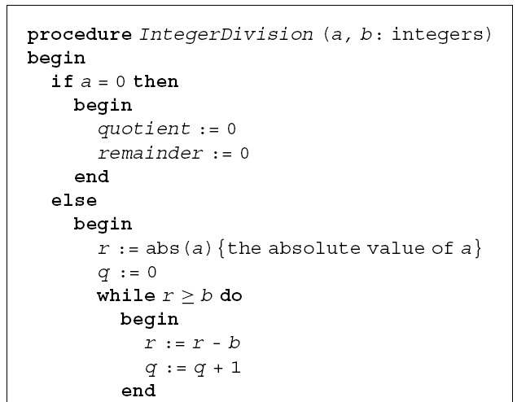
Pseudo Code (1/2)

Slide 58
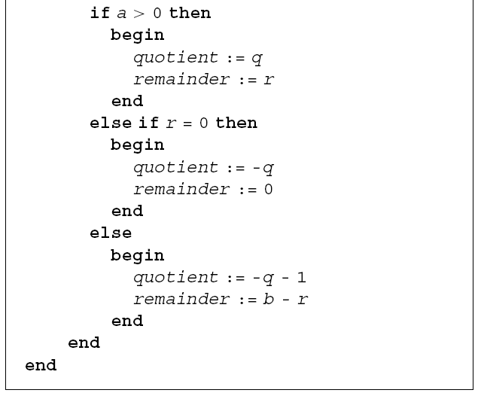
Pseudo Code (2/2)

Slide 59
Octal System
Example 4.27: Write 6137 in the octal system (base 8). Here we seek nonnegative integers r₀, r₁, r₂, …, r_{k}, with 0 < r_{k} < 8, such that 6137 = (r_{k} … r₂ r₁ r₀)₈.
6137 = (13771)₈

Slide 60
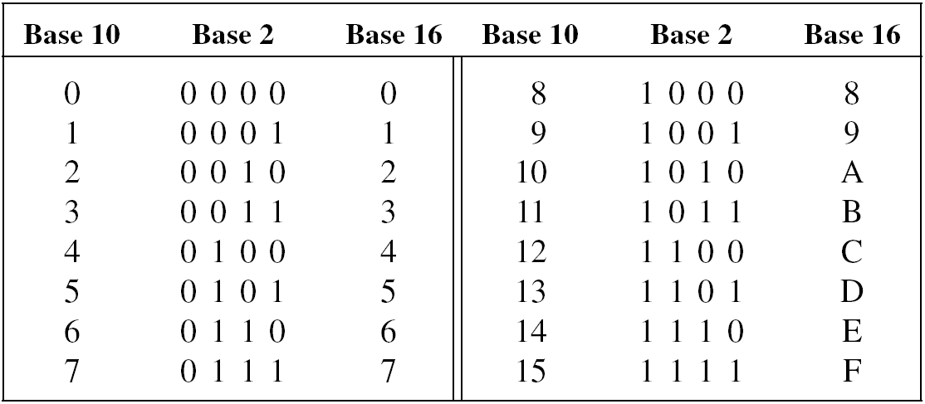
Hexadecimal (Base-16) Number System
Represent the (base-10) integer 13,874,945 in the hexadecimal system.
(D3B701)₁₆

Slide 61

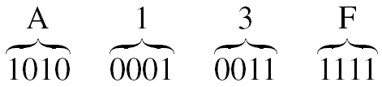
Convert between Base 2 and Base 16
(01001101)₂ = (4D)₁₆
(A13F)₁₆ = (1010000100111111)₂

Slide 62
Two’s Complement Method (1/2)
We need negative integers to perform the binary operation of subtraction in terms of addition.
To obtain the four-bit patterns for –8 ≤ n ≤ –1, do the following:
Replace each 0(1) in the binary representation of |n| by 1(0). (one’s complement of |n|)
Add 1 (=0001 in this case) to the result in step (1). (two’s complement of |n|)

Slide 63
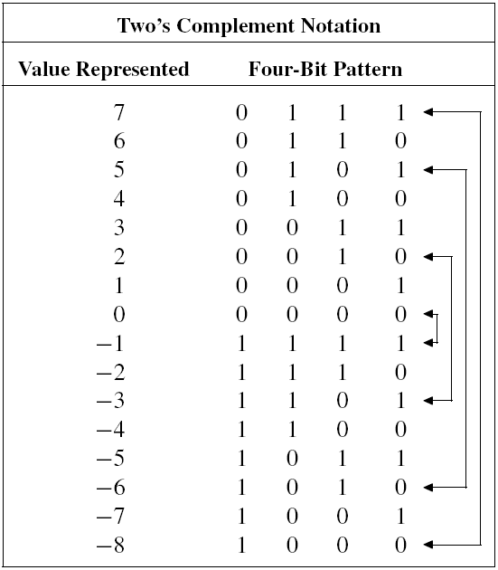
Two’s Complement Method (2/2)
Notes:
The four-bit patterns for the nonnegative integers start with 0, where as a is the first bit for the negative integers in the table.

Slide 64
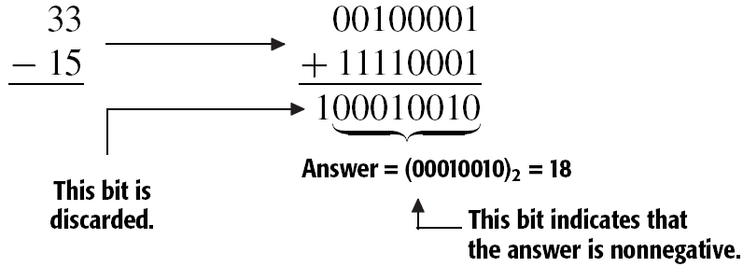
Subtraction in Base 2 (1/3)
Example 4.30: How do we perform the subtraction 33 – 15 in base 2, using the two’s complement method with patterns of eight bits (= one byte)?
33 – 15 = 33 + (–15)

Slide 65
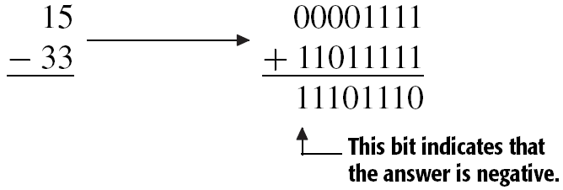
Subtraction in Base 2 (2/3)
Example 4.30 (cont.):
To find 15 – 33 we use 15 = (00001111)₂ and 33 = (00100001)₂.

Slide 66
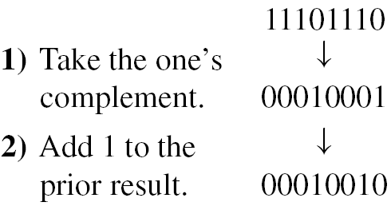
Subtraction in Base 2 (3/3)
Example 4.30 (cont.):
In order to get the positive form of the answer, we proceed as follows:
Since (00010010)₂ = 18, the answer is –18.

Slide 67
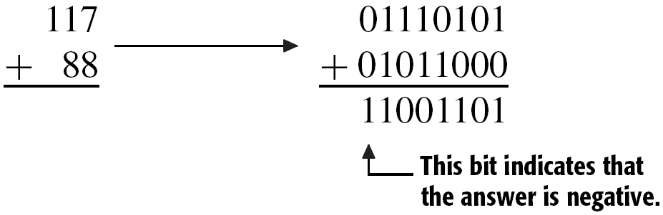
Overflow Error
When we exceed the size of the integers that can be represented, an overflow error results.
Here an overflow error is indicated: The sum of the eight-bit patterns for two positive (negative) integers has resulted in the eight-bit pattern for a negative (positive) integer.

Slide 68




One Result on Composite Integers (1/2)
Example 4.31: If n ∈ Z⁺ and n is composite, then there exists a prime p such that p|n and
Proof:
Since n is a composite, we can write n = n₁n₂, where 1 < n₁ < n and 1 < n₂ < n.
We claim that one of n₁ , n₂ must be less than or equal to
If not, then and give us a contradiction .

Slide 69

One Result on Composite Integers (2/2)
Example 4.31 (cont.):
Without loss of generality, we assume
(i) If n₁ is prime, the statement is true.
(ii) If n₁ is not prime, then by Lemma 4.1 there exists a prime p < n₁ where p|n₁.
So p|n and
EXERCISES 4.3: 10, 12, 18

Slide 70
Outline
The Well-Ordering Principle: Mathematical Induction
Recursive Definitions
The Division Algorithm: Prime Numbers
The Greatest Common Divisor: The Euclidean Algorithm
The Fundamental Theorem of Arithmetic

Slide 71
Common Divisor
Definition 4.2: For a, b ∈ Z, a positive integer c is said to be a common divisor of a and b if c|a and c|b.
Example 4.32: The common divisors of 42 and 70 are 1, 2, 7, and 14, and 14 is the greatest of the common divisors.

Slide 72
Greatest Common Divisor
Definition 4.3: Let a, b ∈ Z, where either a ≠ 0 or b ≠ 0. Then c ∈ Z⁺ is called a greatest common divisor of a, b if
a) c|a and c|b
b) for any common divisor d of a and b, we have d|c.
Questions:
  Does a greatest common divisor of a and b always exist? If so, how does one find such an integer?
  How many greatest common divisors can a pair of integers have?

Slide 73
Uniqueness of GCD (1/2)
Theorem 4.6: For all a, b ∈ Z⁺, there exists a unique c ∈ Z⁺ that is the greatest common divisor of a, b.
Proof: Given a, b ∈ Z⁺, let S = {as + bt | s, t ∈ Z, as + bt > 0}. Since S ≠ ∅, by the Well-Ordering Principle S has a least element c.
(i) Existence: We claim that c is a greatest common divisor of a, b.
  Since c ∈ S, c = ax + by, for some x, y ∈ Z.
  Consequently, if d ∈ Z and d|a and d|b, then by Theorem 4.3 (f) d|(ax +by), so d|c.
Notes:
先證存在, 再證唯一
存在：先證 divisor 都可整除 c (definition 4.3 (b)), 再證 c 可整除 a, b (definition 4.3 (a)) ➔ c 是 GCD

Slide 74
Uniqueness of GCD (2/2)
Theorem 4.6 (cont.):
  If c a, a = qc + r, with q, r ∈ Z⁺ and 0 < r < c.
  Then r = a – qc = a – q(ax + by) = (1 – qx)a + (–qy)b
  r ∈ S, contradicting the choice of c as the least element of S.
  Consequently, c|a, and by similar argument, c|b.
  Hence all a, b ∈ Z⁺ have a greatest common divisor.
(ii) Uniqueness: If c₁, c₂ both satisfy Definition 4.3, then c₁|c₂ and c₂|c₁.
We conclude from Theorem 4.3 (b) that c₁ = c₂ because c₁, c₂ ∈ Z⁺.

Slide 75
Properties of Greatest Common Divisor
The greatest common divisor of a, b is denoted by gcd(a, b).
  gcd(a, b) = gcd(b, a)
  For each a ∈ Z, if a ≠ 0, then gcd(a, 0) = |a|
  When a, b ∈ Z, gcd(–a, b) = gcd(a, –b) = gcd(–a, –b) = gcd(a, b)
  gcd(0, 0) is not defined and is of no interest to us.
  gcd(a, b) is the smallest positive integer we can write as a linear combination of a and b.
  Integers a and b are called relatively prime when gcd(a, b) = 1 – that is, when there exist x, y ∈ Z with ax + by = 1.

Slide 76
Example
Example 4.33: Since gcd(42, 70) = 14, we can find x, y ∈ Z with 42x + 70y = 14, or 3x + 5y = 1. Is the solution for x, y unique?
By inspection x = 2, y = –1 is a solution.
But for k ∈ Z, 1 = 3(2 – 5k) + 5(–1 + 3k), so 14 = 42(2 – 5k) + 70(–1 + 3k), and the solutions for x, y are not unique.
In general, if gcd(a, b) = d, then gcd((a/d), (b/d)) = 1. If (a/d)x₀ + (b/d)y₀ = 1, then 1 = (a/d)(x₀ – (b/d)k) + (b/d)(y₀ + (a/d)k), for each k ∈ Z. So d = a(x₀ – (b/d)k) + b(y₀ + (a/d)k), yielding infinitely many solutions to ax + by = d.

Slide 77
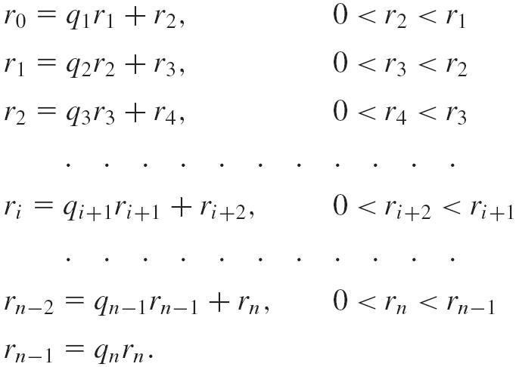
Euclidean Algorithm (1/3)
Theorem 4.7: Euclidean Algorithm. Let a, b ∈ Z⁺. Set r₀ = a and r₁ = b and apply the division algorithm n times as follows:

Slide 78
Euclidean Algorithm (2/3)
Theorem 4.7 (cont.):
Then r_{n}, the last nonzero remainder, equals gcd(a, b).
Proof: To verify that r_{n} = gcd(a, b), we establish the two definitions of Definition 4.3.
(i) Verify c|r_{n} for any common divisor c of a and b
If c|r₀ and c|r₁, then as r₀ = q₁r₁ + r₂, it follows c|r₂.
Next [(c|r₁) ∧ (c|r₂)] ⇒ c|r₃
Continuing down ⇒ c|r_{n}

Slide 79
Euclidean Algorithm (3/3)
Theorem 4.7 (cont.):
(ii) Verify r_{n}|a and r_{n}|b
Since r_{n}|r_{n–1} and r_{n–2} = q_{n–1}r_{n–1} + r_{n}, we have r_{n}|r_{n–2}.
Continuing up through the equations, we get to where r_{n}|r₄ and r_{n}|r₃, so r_{n}|r₂.
Then [(r_{n}|r₃) ∧ (r_{n}|r₂)] ⇒ r_{n}|r₁ (that is, r_{n}|b).
Finally, [(r_{n}|r₂) ∧ (r_{n}|r₁)] ⇒ r_{n}|r₀ (that is, r_{n}|a).
Hence, r_{n} = gcd(a, b).

Slide 80
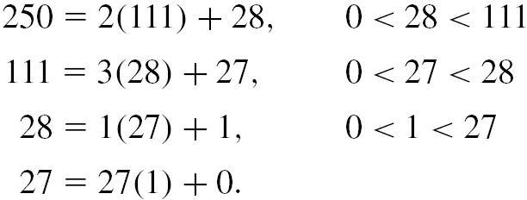
Example (1/2)
Example 4.34: Find the greatest common divisor of 250 and 111, and express the result as a linear combination of these integers.
gcd(250, 111) = 1
250 and 111 are relatively prime.
1 = 250[4 – 111k] + 111[–9 + 250k], for any k ∈ Z.
Notes:
1 = 28 – 1(27) = 28 – 1[111 – 3(28)] = (-1)(111) + 4(28) = (-1)(111) + 4[250 – 2(111)] = 4(250) – 9(111) = 250(4) + 111(-9)

Slide 81
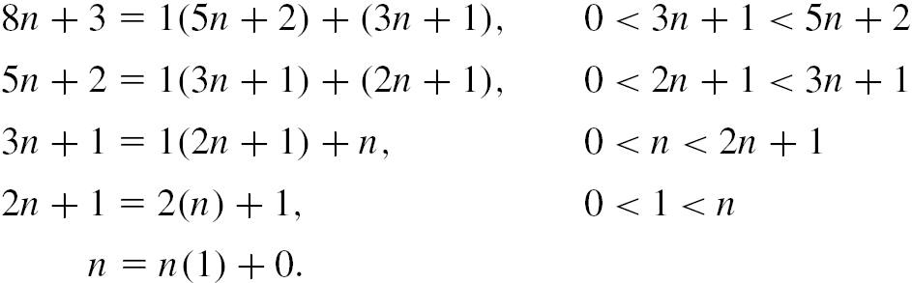
Example (2/2)
Example 4.35: For any n ∈ Z⁺, prove that the integers 8n + 3 and 5n + 2 are relatively prime.
When n = 1 we find that gcd(8n + 3, 5n + 2) = gcd(11, 7) = 1.
For n ≥ 2 we have 8n + 3 > 5n + 2, we may write
Consequently, the last nonzero remainder is 1, so gcd(8n + 3, 5n + 2) = 1, for all n ≥ 1.

Slide 82
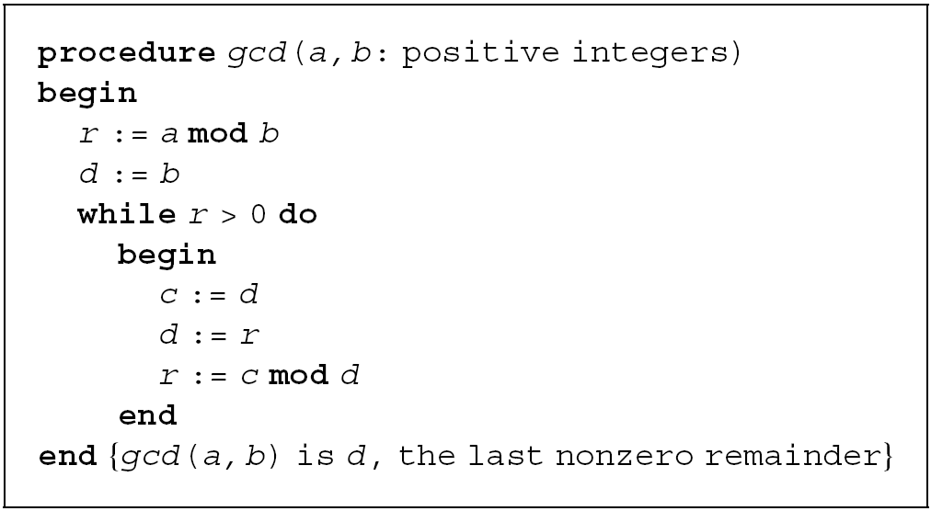
Procedure of Euclidean Algorithm

Slide 83
Example
Example 4.37: Griffin has two unmarked containers. One container holds 17 ounces and the other holds 55 ounces. Explain how Griffin can use his two containers to measure exactly one ounce.
55 = 3(17) + 4, 0 < 4 < 17
17 = 4(4) + 1, 0 < 1 < 4
Therefore 1 = 17 – 4(4) = 17 – 4[55 – 3(17)]
= 13(17) – 4(55).

Slide 84
Diophantine Equation (1/2)
Example 4.38: On the average, Brian debug a Java program in six minutes, but it takes 10 minutes to debug a C++ program. If he works for 104 minutes and doesn’t waste any time, how many programs can be debug in each language.
We seek integers x, y ≥ 0, where 6x + 10y = 104, or 3x + 5y = 52.
As gcd(3, 5) = 1, we can write 1 = 3(2) + 5(–1), so 52 = 3(104) + 5(–52)
= 3(104 – 5k) + 5(–52 + 3k), k ∈ Z.

Slide 85
Diophantine Equation (2/2)
Example 4.38 (cont.):
Since 0 ≤ x = 104 – 5k and 0 ≤ y = –52 + 3k, we must have (52/3) ≤ k ≤ (104/5). So k = 18, 19, 20.
  a) (k = 18): x = 14, y = 2
  b) (k = 19): x = 9, y = 5
  c) (k = 20): x = 4, y =8
Diophantine equation: a linear equation requiring integer solutions.
Theorem 4.8: If a, b, c ∈ Z⁺, the Diophantine equation ax + by = c has an integer solution x = x₀, y = y₀ if and only if gcd(a, b) divides c.
Notes:
一般而言若 f (x1,..., xn) 是一個多變數的整係數多項式, 求 f (x1,..., xn) = 0 的所有整數解就是 Diophantine equation 的問題

Slide 86
Least Common Multiple (1/2)
Definition 4.4: For a, b, c ∈ Z⁺, c is called a common multiple of a, b if c is a multiple of both a and b. Furthermore, c is the least common multiple of a, b if it is the smallest of all positive integers that are common multiples of a, b. We denote c by lcm(a, b).

Slide 87
Least Common Multiple (2/2)
Theorem 4.9: Let a, b, c ∈ Z⁺, with c = lcm(a, b). If d is a common multiple of a and b, then c|d.
Proof: If not, d = qc + r, where 0 < r < c.
Since c = lcm(a, b), c = ma for some m ∈ Z⁺.
Also, d = na for some n ∈ Z⁺.
Consequently, na = qma + r ⇒ (n – qm)a = r > 0, and r is a multiple of a.
In a similar way r could be a multiple of b, so r is a common multiple of a, b.
But with 0 < r < c, we contradict the claim that c is the least common multiple of a, b. Hence c|d.

Slide 88

GCD and LCM
Theorem 4.10: For all a, b ∈ Z⁺, ab = lcm(a, b) × gcd(a, b).
Example 4.40: By Theorem 4.10, we have
a) For all a, b ∈ Z⁺, if a, b are relatively prime, then lcm(a, b) = ab.
b) Since gcd(168, 456) = 24, we find that
EXERCISES 4.4: 12, 16

Slide 89
Outline
The Well-Ordering Principle: Mathematical Induction
Recursive Definitions
The Division Algorithm: Prime Numbers
The Greatest Common Divisor: The Euclidean Algorithm
The Fundamental Theorem of Arithmetic

Slide 90
Lemmas
Lemma 4.2: a, b ∈ Z⁺ and p is prime, then p|ab ⇒ p|a or p|b.
Proof:
If p|a, then we are finished.
If not, since p is prime, gcd(p, a) = 1, and there exist integers x, y with px + ay = 1.
Then b = p(bx) + (ab)y, where p|p and p|ab.
So p|b (Theorem 4.3 (d) and (e)).
Lemma 4.3: Let a_{i} ∈ Z⁺ for all 1 ≤ i ≤ n. If p is prime and p|a₁a₂…a_{n}, then p|a_{i} for some 1 ≤ i ≤ n.

Slide 91

Example
Example 4.41: Show that is irrational.
Proof: If not, we can write = a/b, where a, b ∈ Z⁺ and gcd(a, b) = 1.
Then = a/b ⇒ 2 = a²/b² ⇒ 2b² = a² ⇒ 2|a² ⇒ 2|a (why?)
Also, 2|a ⇒ a = 2c for some c ∈ Z⁺, so 2b² = a² = (2c)² = 4c² and b² = 2c².
But then 2|b² ⇒ 2|b.
Since 2 divides both a and b, it follows that gcd(a, b) ≥ 2 (contradiction).
Notes:
Lemma 4.2

Slide 92
Fundamental Theorem of Arithmetic (1/3)
Theorem 4.11: Every integer n > 1 can be written as a product of primes uniquely, up to the order of the primes. (Here a single prime is considered a product of one factor.)
Proof:
Existence: If not, let m > 1 be the smallest integer not expressible as a product of primes.
m = m₁m₂ (∵ m is composite), and m₁, m₂ can be written as products of primes (∵ 1 < m₁, m₂ < m)
∴ m can be expressible as a product of primes.

Slide 93
Fundamental Theorem of Arithmetic (2/3)
Theorem 4.11 (cont.):
Uniqueness: (Use alternative form of the Principle of Mathematical Induction: Theorem 4.2)
For the integer 2, we have a unique prime factorization, and assuming uniqueness of representation for 3, 4, 5, …, n – 1.
We suppose that
where each p_{i}, 1 ≤ i ≤ k, and each q_{i}, 1 ≤ j ≤ r, is a prime. Also p₁ < p₂ < … < p_{k}, and q₁ < q₂ < … < q_{r}, and s_{i} > 0 for all 1 ≤ i ≤ k, t_{j} > 0 for all 1 ≤ j ≤ r.

Slide 94

Fundamental Theorem of Arithmetic (3/3)
Theorem 4.11 (cont.):
∵ p₁|n ⇒ ⇒ p₁|q_{j} (Lemma 4.3)
∵ p₁ and q_{j} are primes ⇒ p₁ = q_{j}
In fact j = 1, for otherwise q₁|n ⇒ q₁ = p_{e} for some 1 < e ≤ k and p₁ < p_{e} = q₁ < q_{j} = p₁.
With p₁ = q₁, we find that n₁ = n/p₁ =
Since n₁ < n, by the induction hypothesis it follows that k = r, p_{i} = q_{i} for 1 ≤ i ≤ k, s₁ – 1 = t₁ – 1 (so s₁ = t₁), and s_{i} = t_{i} for 2 ≤ i ≤ k.
Hence the prime factorization of n is unique.

Slide 95

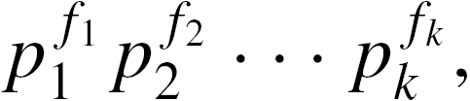
The Number of Positive Divisors (1/3)
For n ∈ Z⁺, we want to count the number of positive divisors of n. The number 2 has two positive divisors: 1 and itself. In the case of 4, we find the three positive divisors 1, 2, and 4.
To determine the result for each n ∈ Z⁺, n > 1, we use Theorem 4.11 and write n =
where for each 1 ≤ i ≤ k, p_{i} is a prime and e_{i} > 0. If m|n, then m = where 0 ≤ f_{i} ≤ e_{i} for all 1 ≤ i ≤ k. So by the rule of product, the number of positive divisors of n is
(e₁ + 1)(e₂ + 1) … (e_{k} + 1).

Slide 96

The Number of Positive Divisors (2/3)
Example 4.44: How many positive divisors do 29,338,848,000 have? How many of the positive divisors are multiples of 360? How many of the positive divisors are perfect squares?
(i) Since 29,338,848,000 = 2⁸3⁵5³7³11, answer = (8 + 1)(5 + 1)(3 + 1)(3 + 1)(1 + 1) = 1728 positive divisors.
(ii) Since 360 = 2³2²5, we want to count the integers of the form where
3 ≤ t₁ ≤ 8, 2 ≤ t₂ ≤ 5, 1 ≤ t₃ ≤ 3, 0 ≤ t₄ ≤ 3, and
0 ≤ t₅ ≤ 1. ∴ answer = [(8 – 3) + 1][(5 – 2) + 1][(3 – 1) + 1][(3 – 0) + 1][(1 – 0) + 1] = 576.

Slide 97

The Number of Positive Divisors (3/3)
Example 4.44 (cont.):
(iii) Consider all divisors of the form
where each of s₁, s₂, s₃, s₄, s₅ is an even nonnegative integer. Consequently, we have
5 choices for s₁ – namely, 0, 2, 4, 6, 8;
3 choices for s₂ – namely, 0, 2, 4;
2 choices for each of s₃, s₄ – namely, 0, 2;
1 choices for s₅ – namely, 0.
∴ answer = (5)(3)(2)(2)(1) = 60.

Slide 98



Pi-Notation
We can use the Pi-notation to express the product x₁ x₂ x₃ x₄ x₅ x₆ as
In general, one can express the product of the n – m + 1 terms x_{m}, x_{m+1}, x_{m+2}, …, x_{n}, where m, n ∈ Z and m ≤ n, as
Example:

Slide 99


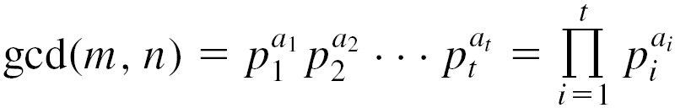
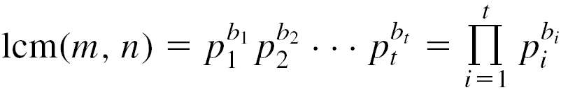
GCD and LCM
Example 4.45: If m, n ∈ Z⁺, let
and , with each p_{i} prime and 0 ≤ e_{i} and 0 ≤ f_{i} for all 1 ≤ i ≤ t. Then if a_{i} = min{e_{i}, f_{i}} and b_{i} = max{e_{i}, f_{i}}, for all 1 ≤ i ≤ t, we have

Slide 100

Perfect Square (1/2)
Example 4.46: Can we find three consecutive positive integers whose product is a perfect square – that is, do there exist m, n ∈ Z⁺ with m(m+1)(m+2) = n²?
Proof: Suppose such m, n do exist.
Use the fact that gcd(m, m+1) = 1 = gcd(m+1, m+2)
For any prime p, if p|(m+1) then p m and p m+2, and p|n².
∵ n² is a perfect square ∴ m+1 is also a perfect square.
Notes:
Hint for gcd(m, m+1) = 1: m+1 = m + 1, 假設 gcd(m,m+1) = c > 1, c|m+1, c|m ➔ c|1 →←
不管 m+1 是prime或composite, 若 p|m, 則p必沒法整除 m及m+2 (因為互質), 又m(m+1)(m+2) = n² 所以p|n²
因為m(m+1)(m+2) = n², (對任一個質數) p 又只在 n² 跟 (m+1) 有, 所以 m+1 也是 perfect square.
假設 n = p1^{x}p2^{y}p3^{z}, n² = p1^{2x}p2^{2y}p3^{2z}
We find that the exponents on p in the prime factorizations of both m+1 and n² must be the same even integer. This is true for each prime divisor of m+1, so m+1 is a perfect square.
對任一個質數p可整除m+1, 則必可整除n², 因為p不可整除m與m+2, 所以p只在m+1跟n²有, 又n²是 perfect square, 所以 m+1也是

Slide 101
Perfect Square (2/2)
Example 4.46 (cont.):
∴ m(m+2) is also a perfect square.
∵ m² < m² + 2m = m(m+2) < m² + 2m + 1 = (m+1)²
∴ m(m+2) cannot be a perfect square.
So, we conclude that there are no three consecutive positive integers whose product is a perfect square.

Slide 102
Homework Assignment #4
EXERCISES 4.1
18, 24
EXERCISES 4.2
12, 16
EXERCISES 4.3
10, 12, 18
EXERCISE 4.4
12, 16
EXERCISE 4.5
8

